Slide 1
How To Program
An Overview
Or
A Reframing of the Question of Programming

Slide 2
An Exercise
Make a program that tells us that it is a program
How does one go about doing this?

Slide 3
What is a program?
A set of instructions
  Receive input, produce output
  Do nothing
  ….
Instructions are written in whatever “language” the machine/device/person/biology can interpret
  1s and 0s
  Protein sequences
  English
  Ruby/python/java/C++/visual basic, etc
  Morse Code
  ….
Language is recognizable data (grammar)
  Letters > words > sentences
  Symbolics (hieroglyphics, Pictograms, etc)
  Circuit arrangements
Instructions are sequences of language components that prescribe doable actions
…..

Slide 4
Possible Approaches
Just write the program, if you know how to program
Search through existing programs until an appropriate one is recognized
  Use google to translate the exercise into finding descriptions of programs
  Use machine learning and statistics to pattern recognize likely candidate programs
Try random sequences of data (1s and 0s or strings etc depending on the programming language) to see if they do what we expect this program to do

Slide 5
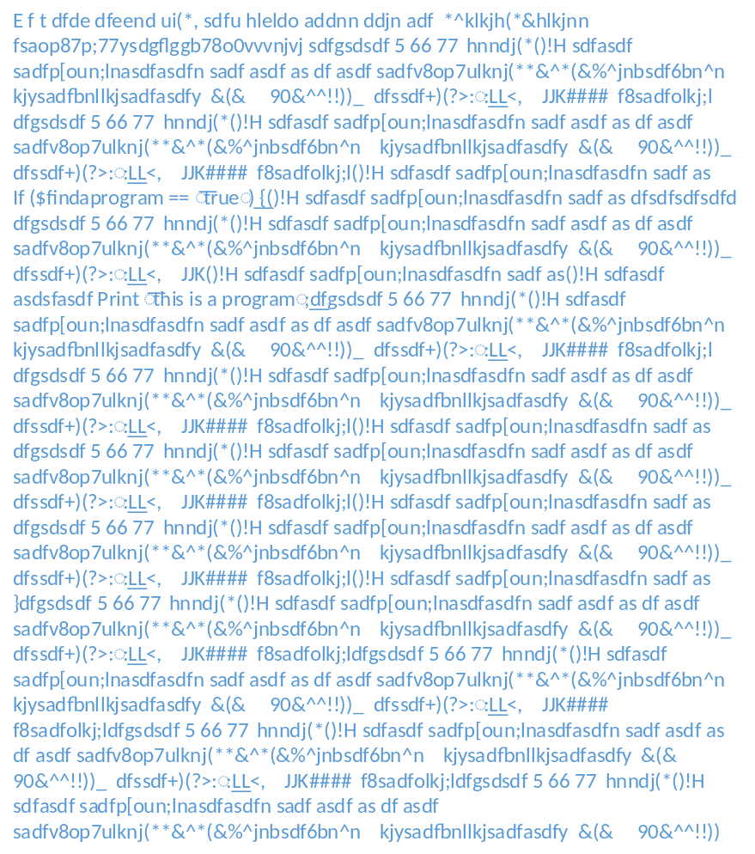
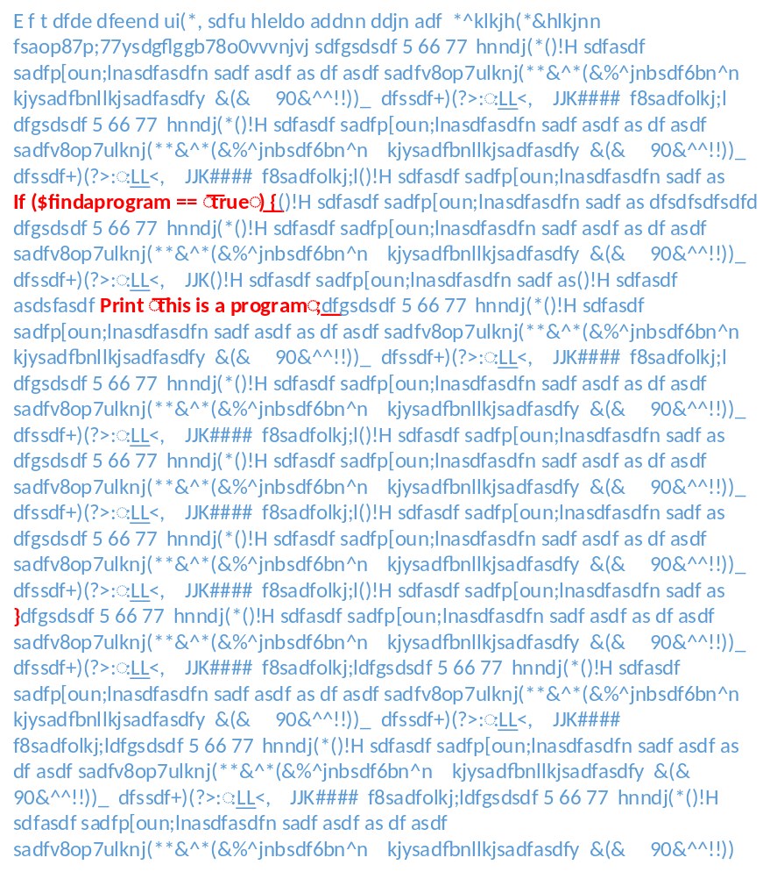
These are all equivalent processes!
Expert Programmer Programs
Search to Find Patterns in databases of programs
Generate All Sequences and Try Running them

Slide 6
Programming is…..
Figuring out how to create and execute instructions in a substrate that can understand them…..
Figure out what instructions we need -> Write Instructions -> Load Them -> Execute -> Validate Behavior / Output -> Repeat

Slide 7
Expert Programmer
Instructions – expert programmers have learned the common instruction sets used in computer programming
Language – expert programmers have learned the common languages (recognizable sets of data) computers can interpret
Doable Actions – expert programs have experience with what actions computers can actual take

Slide 8
Search through known programs
Instructions – a large set of common instruction sets used in computer programming have already been made available on the Web, in books and other documents
Language – The common languages (recognizable sets of data) computers can interpret are well represented on the Web
Doable Actions – the Web has lots of information on what actions computers can actual take

Slide 9
Try Random Sequences
Instructions – machine learning on large clusters is now efficient enough to recognize valid instruction sets
Language – machine learning has made it possible for large clusters to write and interpret the common languages (recognizable sets of data) human and computer and otherwise
Doable Actions – Computers are fast and available enough to do brute force trial and error of actions computers can actual take

Slide 10
Which is the best approach?
It depends!
  What’s the definition of best? Faster? More computationally efficient? Clever? Beautiful?
  How common is the program we wish to use?
Cost Functions!
  Expert programmers are often viewed as extremely efficient, but it’s not really the case
    Take a lot of learning/training
    Typically only efficient in localized/project by project basis
    The complexity of desired programs is increasing beyond a particular person or team of people to be able to fully harness it all
  Really to determine an efficient approach have to factor in the amount of time and resources that goes into reducing the search space for reasonable programs

Slide 11
Let’s Get Meta
What IS Programming? for real this time.
Survival Needs
I need to eat
Questions
Where is food, What is food
Should I go to store?
Simulations
Action
Logical Proof
Go to fridge, if something there, eat it…
Consequences
Hunger growing stronger
Feedback Loops
No food in fridge
Statistics
Pattern Recognition
Food is usually here

Slide 12
Another example…
What IS Programming? for real this time.
Survival Needs
Must make money
Should we make more? Close up?
Questions
What product should we make, sell?
Simulations
Action
Logical Proof
Make products, test them, ask people about them, market them
Consequences
People buy or don’t buy
Feedback Loops
sales, complaints, reviews, word of mouth
Statistics
Pattern Recognition
Money is running out/increasing

Slide 13
And what is it all?
Survival Needs
Questions
Simulations
Action
Logical Proof
DATA
Consequences
Substrates
Chemicals
Biology
Machines
….
Feedback Loops
Statistics
Pattern Recognition

Slide 14
A Few Statements
Programs are made of Data
Programs = Usable Patterns of Data
Programming = Data Mining = Searching Through Patterns of Data
Programs Generate Data
Programs Generate Programs
Data Generates Data
In everyday thinking, a large data set is simply a program (or collection of programs) fully executed
Implication!
  The more capable we get with REALLY LARGE DATA the more obvious that programming is a SEARCH exercise becomes.

Slide 15
Hierarchy
Patterns representing instructions (Grammars)
Data with Patterns (Signal)
All Data (Noise)
Instructions that do interesting things (Programs)
Instructions that do things we like/help us/excite us (Programs we pay for)

Slide 16
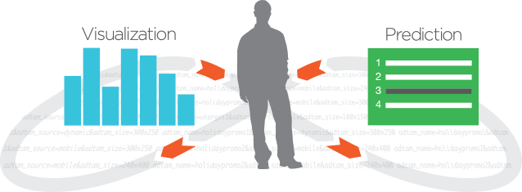
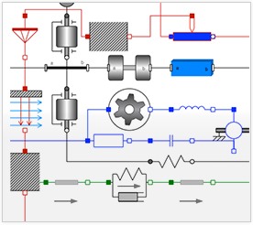
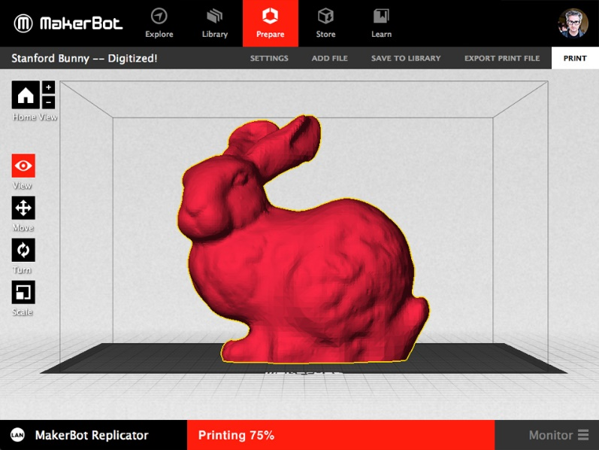
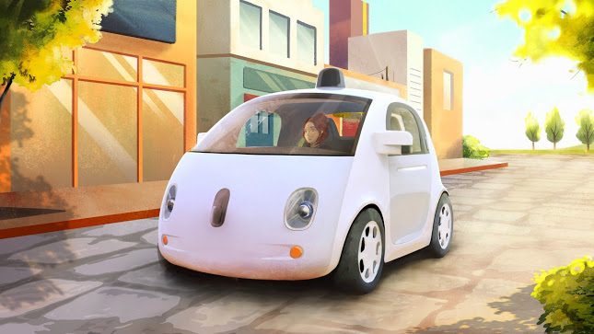

Some Recent Illustrative Examples of Programming Reframed
http://www.trifacta.com/product/platform/
http://www.wolfram.com/system-modeler/features/analysis-mathematica.html#model-creation
http://www.wolfram.com/language/principles/
http://www.makerbot.com/
https://plus.google.com/+GoogleSelfDrivingCars/posts
http://www.newscientist.com/article/dn25894-meet-the-electric-life-forms-that-live-on-pure-energy.html#.U910QfldWhM

Slide 17
What’s the Point? Or rather some points…
We’re all programmers… we’re made of programs…
Self Reference is important concept
  http://en.wikipedia.org/wiki/Self-reference_effect
  http://en.wikipedia.org/wiki/Strange_loop
  http://en.wikipedia.org/wiki/G%C3%B6del's_incompleteness_theorems#Role_of_self-reference
  http://w3.math.uminho.pt/~jes/AnoTuring/SlidesKozen.pdf
Language is weird
  http://en.wikipedia.org/wiki/Context-free_grammar
  http://cs.haifa.ac.il/~shuly/teaching/08/nlp/complexity.pdf
Some of us prefer the silicon based substrate to run our programs, some prefer paper, some prefer chemicals, some prefer soundwaves, some prefer paint…
  http://en.wikipedia.org/wiki/DNA_sequencing_theory
  http://www.inmotionmagazine.com/eno1.html
  http://en.wikipedia.org/wiki/Music_theory
  http://en.wikipedia.org/wiki/Formal_analysis
  http://www.quantumdiaries.org/2013/08/19/a-fresh-look-for-the-standard-model/
  http://en.wikipedia.org/wiki/Proof_theory
  http://en.wikipedia.org/wiki/Herbert_A._Simon

